Slide 1
Spin Locks and Contention
By Guy Kalinski

Slide 2

Outline:
Welcome to the Real World
Test-And-Set Locks
Exponential Backoff
Queue Locks

Slide 3
Motivation
When writing programs for uniprocessors, it is usually safe to ignore the underlying system’s architectural details.
Unfortunately, multiprocessor programming has yet to reach that state, and for the time being, it is crucial to understand the underlying machine architecture.
Our goal is to understand how architecture affects performance, and how to exploit this knowledge to write efficient concurrent programs.

Slide 4
Definitions
When we cannot acquire the lock there are two options:
Repeatedly testing the lock is called spinning
(The Filter and Bakery algorithms are spin locks)
When should we use spinning?
When we expect the lock delay to be short.

Slide 5
Definitions cont’d
Suspending yourself and asking the operating system’s scheduler to schedule another thread on your processor is called blocking
Because switching from one thread to another is expensive, blocking makes sense only if you expect the lock delay to be long.

Slide 6
Welcome to the Real World
In order to implement an efficient lock why
shouldn’t we use algorithms such as Filter or
Bakery?
The space lower bound – is linear in the number of maximum threads
Real World algorithms’ correctness

Slide 7
Recall Peterson Lock:
1 class Peterson implements Lock {
2 private boolean[] flag = new boolean[2];
3 private int victim;
4 public void lock() {
5 int i = ThreadID.get(); // either 0 or 1
6 int j = 1-i;
7 flag[i] = true;
8 victim = i;
9 while (flag[j] && victim == i) {}; // spin
10 }
11 }
We proved that it provides starvation-free mutual exclusion.

Slide 8
Why does it fail then?
Not because of our logic, but because of wrong
assumptions about the real world.
Mutual exclusion depends on the order of steps in
lines 7, 8, 9. In our proof we assumed that our
memory is sequentially consistent.
However, modern multiprocessors typically do not
provide sequentially consistent memory.

Slide 9
Why not?
Compilers often reorder instructions to enhance performance
Multiprocessor’s hardware –
writes to multiprocessor memory do not necessarily take effect when they are issued.
On many multiprocessor architectures, writes to shared memory are buffered in a special write buffer, to be written in memory only when needed.

Slide 10
How to prevent the reordering resulting from write buffering?
Modern architectures provide us a special memory
barrier instruction that forces outstanding
operations to take effect.
Memory barriers are expensive, about as
expensive as an atomic compareAndSet()
instruction.
Therefore, we’ll try to design algorithms that
directly use operations like compareAndSet() or
getAndSet().

Slide 11
Review getAndSet()
public class AtomicBoolean {
boolean value;
public synchronized boolean getAndSet(boolean
newValue) {
boolean prior = value;
value = newValue;
return prior;
}
}
getAndSet(true) (equals to testAndSet()) atomically stores
true in the word, and returns the world’s current value.

Slide 12
Test-and-Set Lock
public class TASLock implements Lock {
AtomicBoolean state = new AtomicBoolean(false);
public void lock() {
while (state.getAndSet(true)) {}
}
public void unlock() {
state.set(false);
}
}
The lock is free when the word’s value is false and busy
when it’s true.

Slide 13
Space Complexity
TAS spin-lock has small “footprint”
N thread spin-lock uses O(1) space
As opposed to O(n) Peterson/Bakery
How did we overcome the Ω(n) lower bound?
We used a RMW (read-modify-write) operation.

Slide 14
Graph
no speedup because of sequential bottleneck
time
ideal
threads

Slide 15
Performance
TAS lock
Ideal
time
threads

Slide 16
Test-and-Test-and-Set
public class TTASLock implements Lock {
AtomicBoolean state = new AtomicBoolean(false);
public void lock() {
while (true) {
while (state.get()) {};
if (!state.getAndSet(true))
return;
}
}
public void unlock() {
state.set(false);
}
}

Slide 17
Are they equivalent?
The TASLock and TTASLock algorithms are equivalent
from the point of view of correctness: they guarantee
Deadlock-free mutual exclusion.
They also seem to have equal performance, but
how do they compare on a real multiprocessor?

Slide 18
No… (they are not equivalent)
Although TTAS performs better than TAS, it still
falls far short of the ideal. Why?
TAS lock
TTAS lock
Ideal
time
threads

Slide 19
Our memory model
Bus-Based Architectures
cache
cache
cache
Bus
memory

Slide 20
So why does TAS performs so poorly?
Each getAndSet() is broadcast to the bus. because
all threads must use the bus to communicate with
memory, these getAndSet() calls delay all threads,
even those not waiting for the lock.
Even worse, the getAndSet() call forces other
processors to discard their own cached copies of
the lock, so every spinning thread encounters a
cache miss almost every time, and must use the
bus to fetch the new, but unchanged value.

Slide 21

Why is TTAS better?
We use less getAndSet() calls.
However, when the lock is released we still have the same problem.

Slide 22
Exponential Backoff
Definition:
Contention occurs when multiple threads try to acquire
the lock. High contention means there are many such
threads.
P₁
P₂
P_{n}

Slide 23
Exponential Backoff
The idea: If some other thread acquires the lock between the first and the second step there is probably high contention for the lock.
Therefore, we’ll back off for some time, giving competing threads a chance to finish.
How long should we back off? Exponentially.
Also, in order to avoid a lock-step (means all trying to acquire the lock at the same time), the thread back off for a random time. Each time it fails, it doubles the expected back-off time, up to a fixed maximum.

Slide 24
The Backoff class:
public class Backoff {
final int minDelay, maxDelay;
int limit;
final Random random;
public Backoff(int min, int max) {
minDelay = min;
maxDelay = max;
limit = minDelay;
random = new Random();
}
public void backoff() throws InterruptedException {
int delay = random.nextInt(limit);
limit = Math.min(maxDelay, 2 * limit);
Thread.sleep(delay);
}
}

Slide 25
The algorithm
public class BackoffLock implements Lock {
private AtomicBoolean state = new AtomicBoolean(false);
private static final int MIN_DELAY = ...;
private static final int MAX_DELAY = ...;
public void lock() {
Backoff backoff = new Backoff(MIN_DELAY, MAX_DELAY);
while (true) {
while (state.get()) {};
if (!state.getAndSet(true)) { return; }
else { backoff.backoff(); }
}
}
public void unlock() {
state.set(false);
}
...
}

Slide 26

Backoff: Other Issues
Good:
  Easy to implement
  Beats TTAS lock
Bad:
  Must choose parameters carefully
  Not portable across platforms
TTAS Lock
time
Backoff lock
threads

Slide 27
There are two problems with the BackoffLock:
Cache-coherence Traffic:
  All threads spin on the same shared location causing
  cache-coherence traffic on every successful lock access.
Critical Section Underutilization:
  Threads might back off for too long cause the critical
  section to be underutilized.

Slide 28
Idea
To overcome these problems we form a queue.
In a queue, every thread can learn if his turn has arrived by
checking whether his predecessor has finished.
A queue also has better utilization of the critical section
because there is no need to guess when is your turn.
We’ll now see different ways to implement such queue locks..

Slide 29
Anderson Queue Lock
idle
acquiring
tail
getAndIncrement
Mine!
flags
T
F
F
F
F
F
F
F

Slide 30
Anderson Queue Lock
acquired
acquiring
acquired
tail
Yow!
flags
getAndIncrement
T
F
F
F
F
F
F
F
T
T

Slide 31
Anderson Queue Lock
public class ALock implements Lock {
ThreadLocal<Integer> mySlotIndex = new
ThreadLocal<Integer> (){
protected Integer initialValue() {
return 0;
}
};
AtomicInteger tail;
boolean[] flag;
int size;
public ALock(int capacity) {
size = capacity;
tail = new AtomicInteger(0);
flag = new boolean[capacity];
flag[0] = true;
}
public void lock() {
int slot = tail.getAndIncrement() % size;
mySlotIndex.set(slot);
while (! flag[slot]) {};
}
public void unlock() {
int slot = mySlotIndex.get();
flag[slot] = false;
flag[(slot + 1) % size] = true;
}
}

Slide 32
Performance
TTAS
Shorter handover than backoff
Curve is practically flat
Scalable performance
FIFO fairness
queue

Slide 33
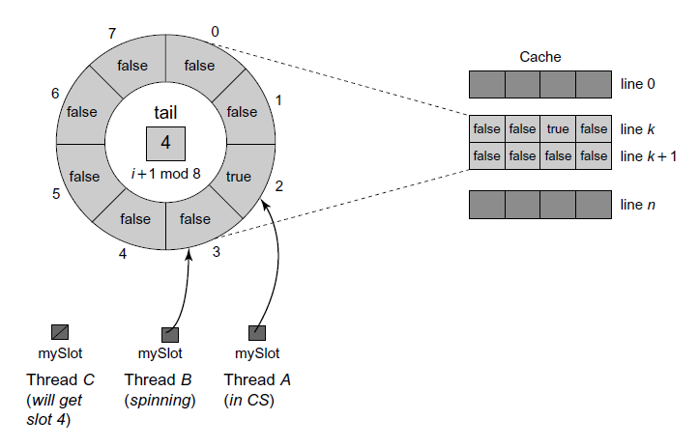
Problems with Anderson-Lock
“False sharing” – occurs when adjacent data items share a single cache line. A write to one item
invalidates that item’s cache line,
which causes invalidation traffic to processors that are spinning on unchanged but near items.

Slide 34
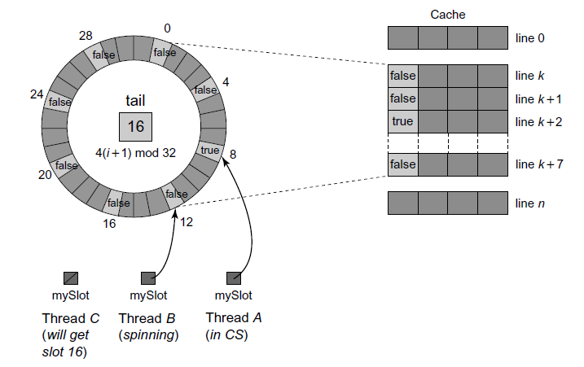
A solution:
Pad array elements so that
distinct elements are mapped to distinct cache lines.

Slide 35
Another problem:
The ALock is not space-efficient.
First, we need to know our bound of maximum threads (n).
Second, lets say we need L locks, each lock allocates an array of size n. that requires O(Ln) space.

Slide 36
CLH Queue Lock
We’ll now study a more space efficient queue lock..

Slide 37
CLH Queue Lock
acquiring
acquired
idle
idle
Swap
Queue tail
Lock is free
tail
false
true
false

Slide 38
CLH Queue Lock
acquired
released
release
acquiring
acquired
Bingo!
Actually, it
spins on
cached copy
true
false
Swap
tail
false
false
true
true

Slide 39
CLH Queue Lock
class Qnode {
AtomicBoolean locked = new AtomicBoolean(true);
}
class CLHLock implements Lock {
AtomicReference<Qnode> tail;
ThreadLocal<Qnode> myNode = new Qnode();
ThreadLocal<Qnode> myPred;
public void lock() {
myNode.locked.set(true);
Qnode pred = tail.getAndSet(myNode);
myPred.set(pred);
while (pred.locked) {}
}
public void unlock() {
myNode.locked.set(false);
myNode.set(myPred.get());
}
}

Slide 40
CLH Queue Lock
Advantages
  When lock is released it invalidates only its successor’s cache
  Requires only O(L+n) space
  Does not require knowledge of the number of threads that might access the lock
Disadvantages
  Performs poorly for NUMA architectures

Slide 41
MCS Lock
acquiring
acquired
idle
(allocate Qnode)
swap
true
tail

Slide 42
MCS Lock
acquiring
acquired
Yes!
true
tail
true
false
swap

Slide 43
MCS Queue Lock
1 public class MCSLock implements Lock {
2 AtomicReference<QNode> tail;
3 ThreadLocal<QNode> myNode;
4 public MCSLock() {
5 queue = new AtomicReference<QNode>(null);
6 myNode = new ThreadLocal<QNode>() {
7 protected QNode initialValue() {
8 return new QNode();
9 }
10 };
11 }
12 ...
13 class QNode {
14 boolean locked = false;
15 QNode next = null;
16 }
17 }

Slide 44
MCS Queue Lock
18 public void lock() {
19 QNode qnode = myNode.get();
20 QNode pred = tail.getAndSet(qnode);
21 if (pred != null) {
22 qnode.locked = true;
23 pred.next = qnode;
24 // wait until predecessor gives up the lock
25 while (qnode.locked) {}
26 }
27 }
28 public void unlock() {
29 QNode qnode = myNode.get();
30 if (qnode.next == null) {
31 if (tail.compareAndSet(qnode, null))
32 return;
33 // wait until predecessor fills in its next field
34 while (qnode.next == null) {}
35 }
36 qnode.next.locked = false;
37 qnode.next = null;
38 }

Slide 45
MCS Queue Lock
Advantages:
  Shares the advantages of the CLHLock
  Better suited than CLH to NUMA architectures because each thread controls the location on which it spins
Drawbacks:
  Releasing a lock requires spinning
  It requires more reads, writes, and compareAndSet() calls than the CLHLock.

Slide 46
Abortable Locks
The Java Lock interface includes a trylock()
method that allows the caller to specify a timeout.
Abandoning a BackoffLock is trivial:
just return from the lock() call.
Also, it is wait-free and requires only a constant
number of steps.
What about Queue locks?

Slide 47
Queue Locks
spinning
spinning
locked
locked
spinning
locked
true
false
true
false
true
false

Slide 48
Queue Locks
spinning
pwned
locked
spinning
spinning
true
true
false
true
false

Slide 49
Our approach:
When a thread times out, it marks its node as
abandoned. Its successor in the
queue, if there is one, notices that the node on
which it is spinning has been abandoned, and
starts spinning on the abandoned node’s predecessor.
The Qnode:
static class QNode {
public QNode pred = null;
}

Slide 50
TOLock
released
locked
spinning
spinning
Timed out
A
The lock is now mine
Non-Null means predecessor aborted
Null means lock is not free & request not aborted

Slide 51
Lock:
1 public boolean tryLock(long time, TimeUnit unit)
2 throws InterruptedException {
3 long startTime = System.currentTimeMillis();
4 long patience = TimeUnit.MILLISECONDS.convert(time, unit);
5 QNode qnode = new QNode();
6 myNode.set(qnode);
7 qnode.pred = null;
8 QNode myPred = tail.getAndSet(qnode);
9 if (myPred == null || myPred.pred == AVAILABLE) {
10 return true;
11 }
12 while (System.currentTimeMillis() - startTime < patience) {
13 QNode predPred = myPred.pred;
14 if (predPred == AVAILABLE) {
15 return true;
16 } else if (predPred != null) {
17 myPred = predPred;
18 }
19 }
20 if (!tail.compareAndSet(qnode, myPred))
21 qnode.pred = myPred;
22 return false;
23 }

Slide 52
UnLock:
24 public void unlock() {
25 QNode qnode = myNode.get();
26 if (!tail.compareAndSet(qnode, null))
27 qnode.pred = AVAILABLE;
28 }

Slide 53
One Lock To Rule Them All?
TTAS+Backoff, CLH, MCS, TOLock.
Each better than others in some way
There is no one solution
Lock we pick really depends on:
  the application
  the hardware
  which properties are important

Slide 54
In conclusion:
Welcome to the Real World
TAS Locks
Backoff Lock
Queue Locks

Slide 55
Questions?

Slide 56
Thank You!

Slide 57
Bibliography
“The Art of Multiprocessor Programming” by Maurice Herlihy & Nir Shavit, chapter 7.
“Synchronization Algorithms and Concurrent Programming” by Gadi Taubenfeld

